Slide 1



EXCAVATE
TEAM NAME : DATA HACKERS

Slide 2

CONTENT
Problem statement
01
Data Visualisation
02
03
Data Preprocessing
04
Models Selection
Test Results
Use in Sustainability Measures

Slide 3

PROBLEM STATEMENT
01
To Investigate intrinsic parameters to understand and predict glass-forming ability, specified in the material's critical casting diameter (Dmax).
02
03
04
05
Analyze the dataset provided
Incorporating new features to the dataset
06
07
08

Slide 4
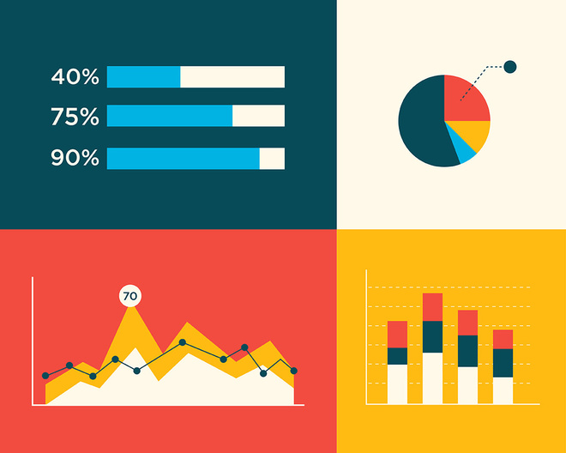
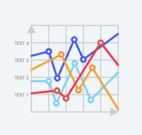
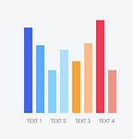

Data Visualization
Next Page

Slide 5
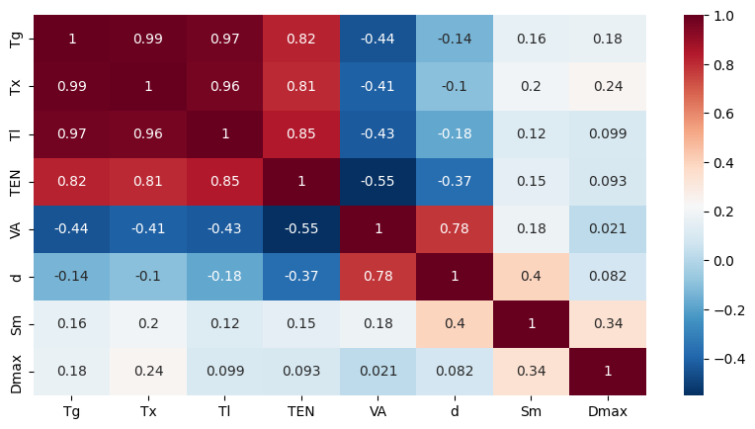
CORRELATION PLOT OF GIVEN SET OF FEATURES
Next Page

Slide 6






FEATURE EXTRACTION
Exploration of characteristic temperature contributions to metallic glass forming ability - ScienceDirect
Relating atomic energy, radius and electronegativity through compression - Chemical Science (RSC Publishing) DOI:10.1039/D0SC06675C
Next Page

Slide 7
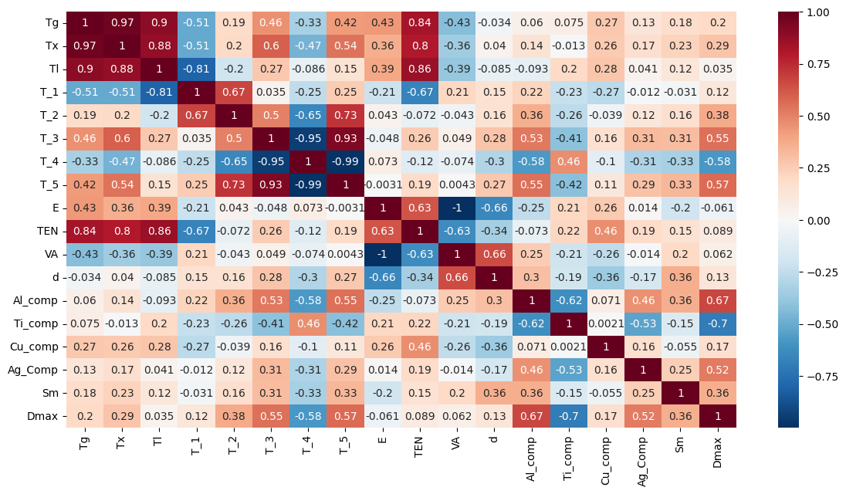
CORRELATION PLOT OF NEW SET OF FEATURES
Next Page

Slide 8
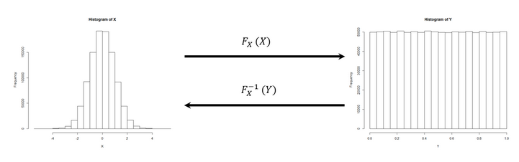
DATA PREPROCESSING
QUANTILE TRANSFORMER
Quantile transformation is a statistical technique used to transform a variable so that its probability distribution matches that of a chosen reference distribution, typically a uniform or normal distribution.
It scales down every feature to (0,1)

Slide 9
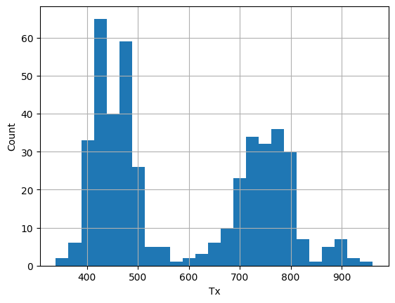
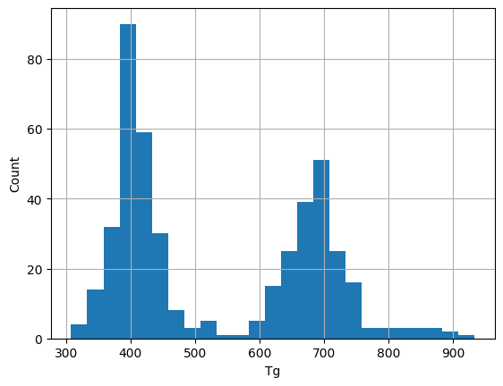
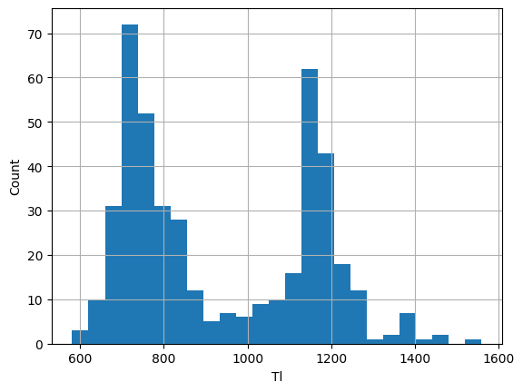
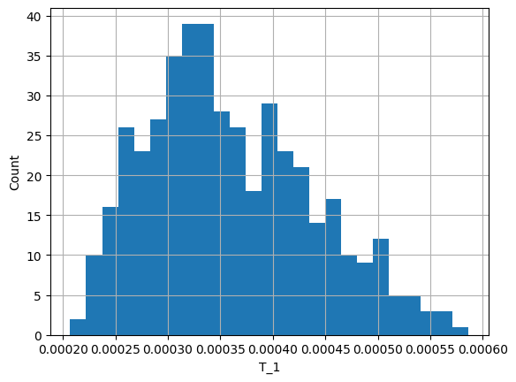
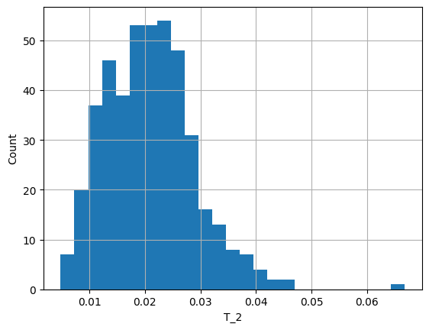
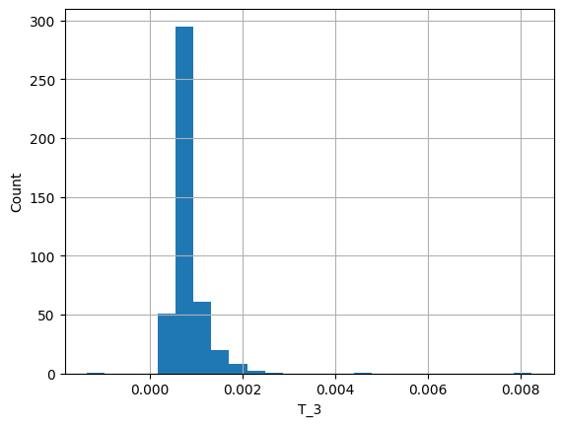
HISTOGRAM PLOT OF DISTRIBUTIONS OF THE FEATURES
Next Page

Slide 10
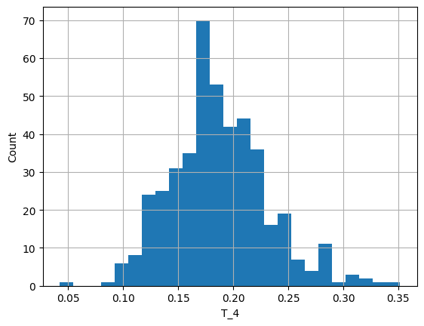
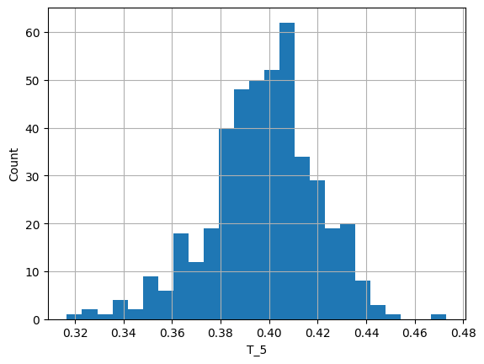
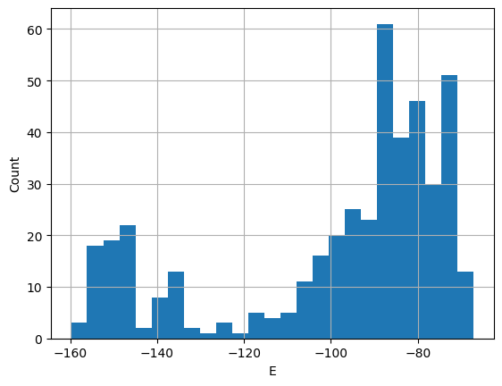
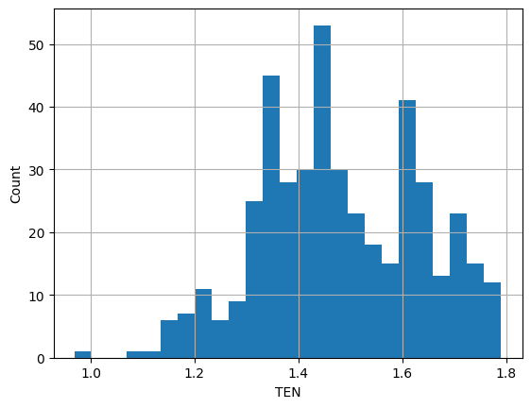
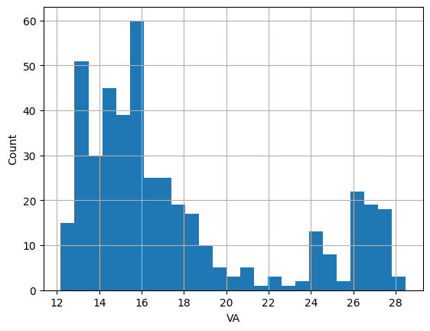
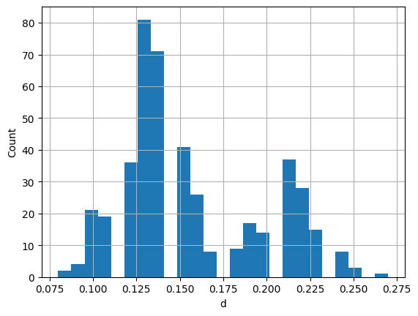
HISTOGRAM PLOT OF DISTRIBUTIONS OF THE FEATURES
Next Page

Slide 11
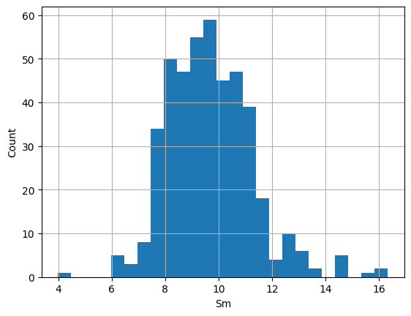
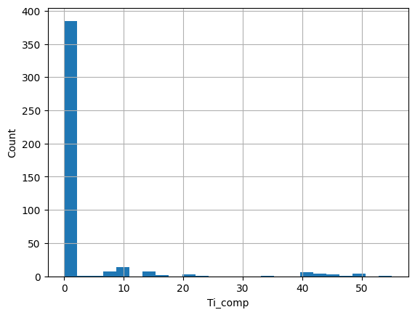
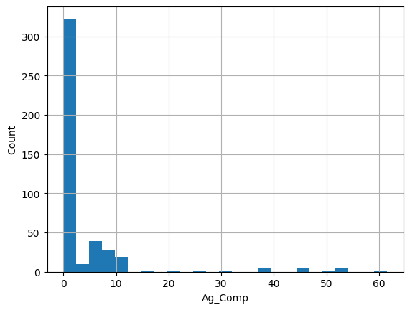
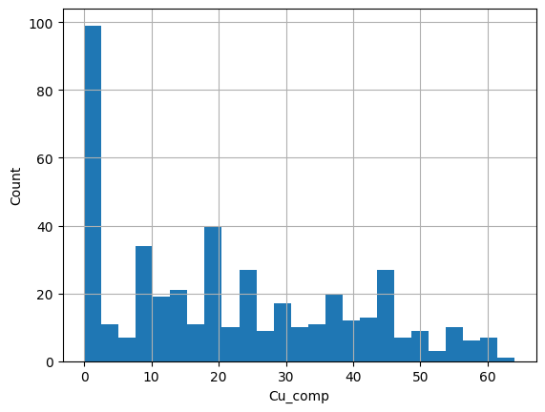
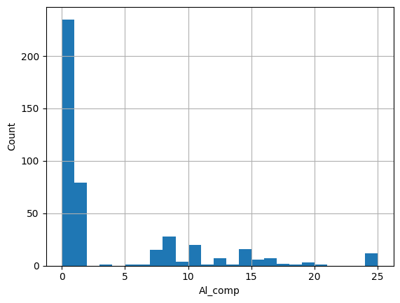
HISTOGRAM PLOT OF DISTRIBUTIONS OF THE FEATURES
Next Page

Slide 12
MODEL SELECTION
Types of Regression models used:-
Random Forest
Gradient boosting
XGBoost
01
Extra Tree Regression
Multilayer Perceptron
Stacking Ensemble Model
02

Slide 13
PREDICTION ACCURACY TESTS
TESTS -
01
Average of R2_scores
02
Standard Deviation of R2_Scores

Slide 14
RESULTS
METHOD | Average of R2 Score | Standard deviation of R2 Score
Random Forest | 0.7877307 | 1.11022 * 10^(-16)
Gradient Boosting | 0.7984139 | 0.0041452
Stacking Ensemble | 0.8140747 | 0.0193195
XGBoost | 0.8444288 | 0.0023562
MLP | 0.8581349 | 0.0053796
Extra Trees Regressor | 0.8669322 | 0.0021421

Slide 15
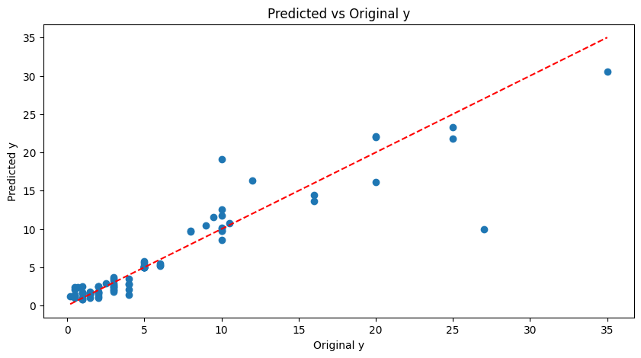
RESULTS

Slide 16


USES IN SUSTAINABILITY MEASURES
Highly recyclable. This reduces the need for raw materials
https://www.ifc.org/en/insights-reports/2021/strengthening-sustainability-in-the-glass-industry
Production methods are energy efficient
resulting in reducing energy consumption and associated greenhouse gas emissions.
https://www.researchgate.net/publication/273146021_Sustainable_Manufacturing_Process_for_Bulk_Metallic_Glasses_Production_Using_Rapid_Solidification_with_Melt_Spinning_Technique
Excellent strength-to-weight ratio. Stronger than many conventional metals while being significantly lighter leading to reduced fuel consumption and emissions thus having applications in consumer electronics and transportation
https://www.sciencedirect.com/science/article/pii/S0079642524000525

Slide 17
CONCLUSION
Major Insights:-
01
The low correlation of the given set of features with Dmax
02
High correlation with some combination of scaled features
03
Dmax also depends on the metallic composition of alloys

Slide 18
Thank You

